Slide 1

Disney | Stock Factor Analysis.
June 30, 2020

Slide 2

Agenda.
Question.
Analysis.
Summary.
What’s next?

Slide 3

Why?
Walt Disney Company
The Walt Disney company is a diverse company that’s more than just an animated film producer.
We wanted to look at if a successful box office could affect the stock price along with other internal and external factors.

Slide 4
The Walt Disney Corporation represented 38% of the US film market in the year 2019, making it the dominant force in American film production. However, theatrically released films make up only a fraction of Disney’s revenue. Our team will look at Disney’s financial statistics and find out which factors most impact the Walt Disney corporation’s market value. We will examine internal factors, like film and online release statistics, as well as more external ones, like unemployment and greater market trends. This will allow our team to examine what has the greatest impact on the most dominant company in entertainment.

Slide 5
Question.
What are some of the factors that affect the price of Walt Disney Company stock?

Slide 6

Analysis.

Slide 7
Gross Profits and Revenue.
We wanted to have a baseline for further analysis, so first we examined the most logical elements to impact the Walt Disney price. To do so we analyzed the Disney’s quarterly reports.

Slide 8
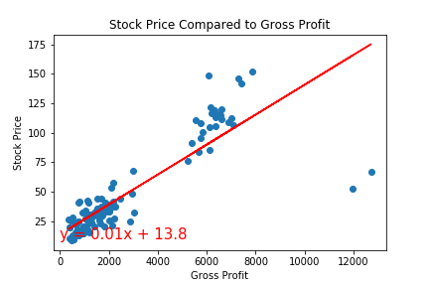
Gross Profits vs. Stock Price
Comparing the gross profits to the share price quarterly, we can see a strong positive correlation just in the graph itself.
The correlation between these two variables in the data set: .85.

Slide 9
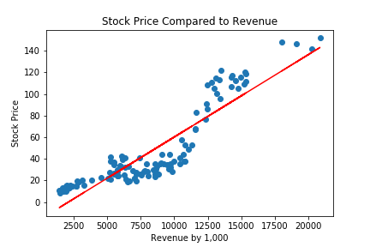
Revenue vs Stock Price
Reported revenue is even more correlated to the quarterly stock price.

Slide 10

Box Office Revenue.

Slide 11
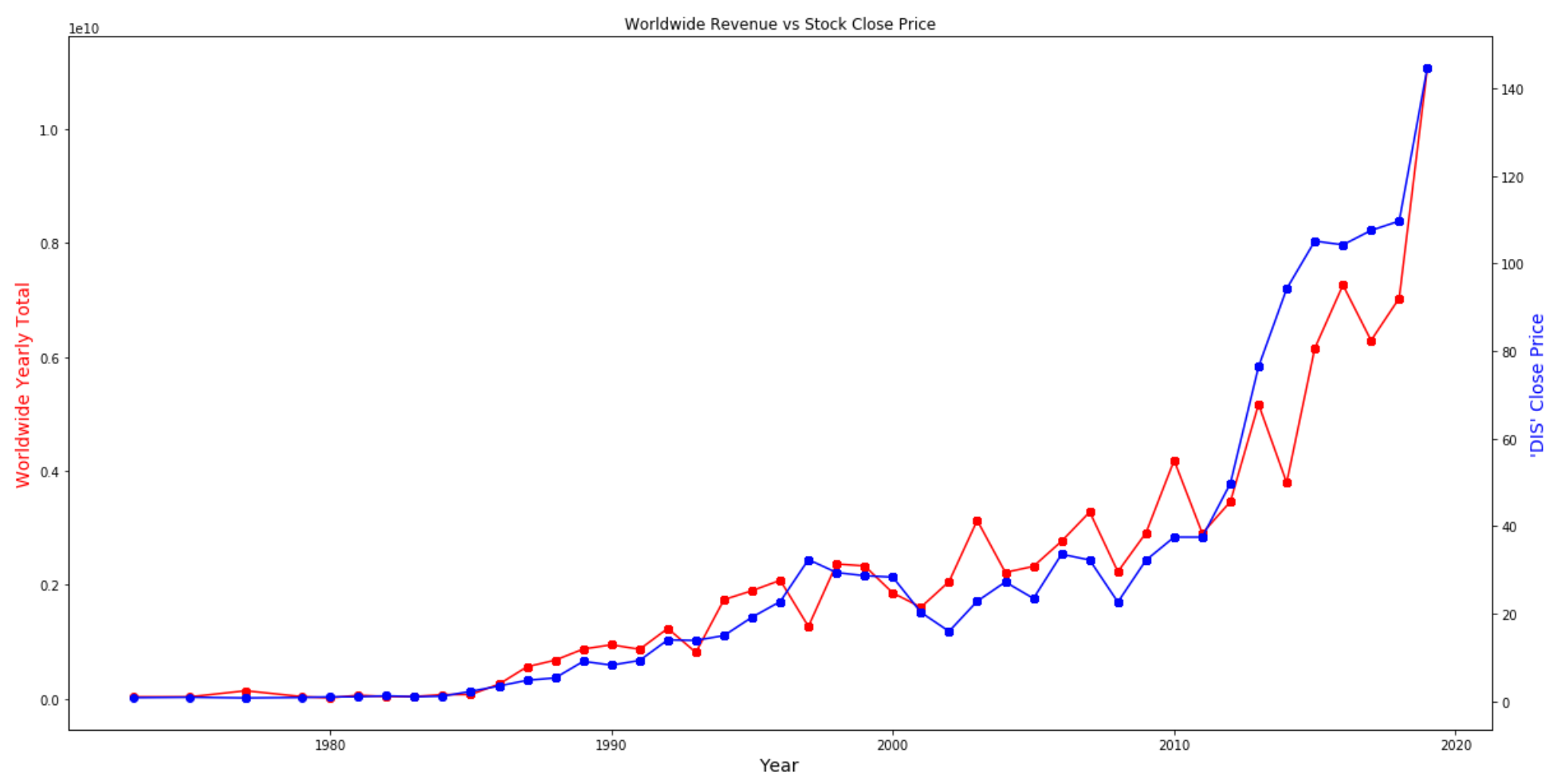
Worldwide Revenue vs Stock Price
The worldwide box revenue shows a strong correlation with the stock price. As seen in the graph on the right, when the worldwide box revenue falls, the stock price drops; when the revenue goes up, the stock price raises.

Slide 12
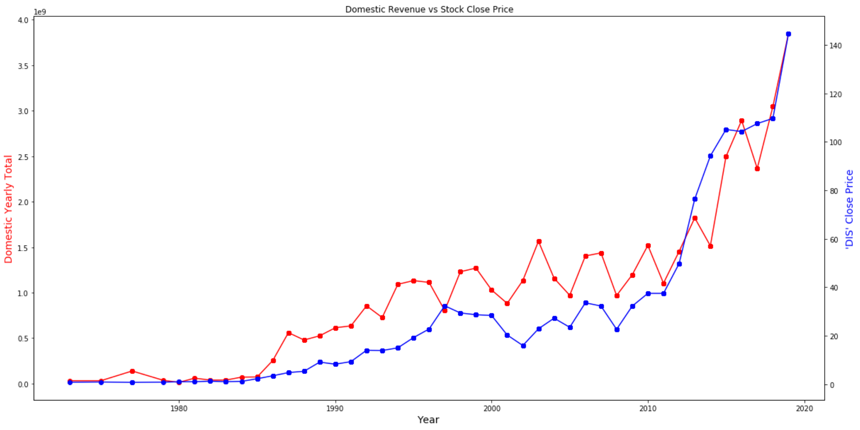
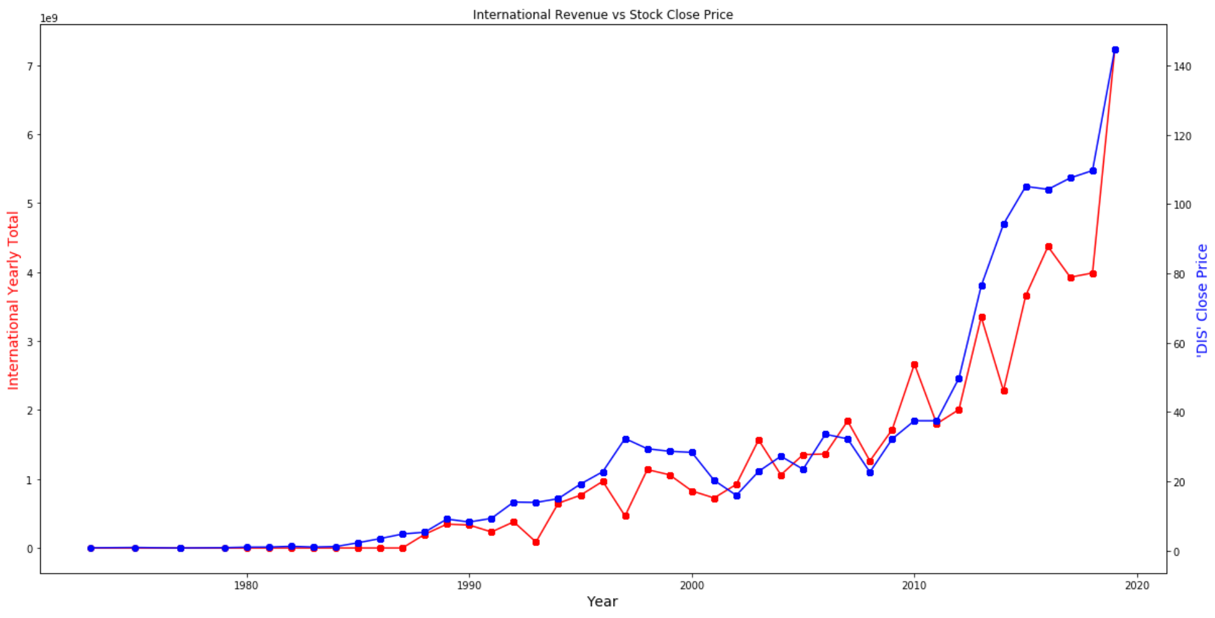
Domestic & International Box Revenue vs Stock Price
There are strong correlations between domestic and international revenue and the stock price. As seen in the two graphs above, when the domestic and international box revenue goes up, the stock price goes up, when the box revenue goes down, the stock price goes down, vice versa. The graph movement in revenue for domestic and international markets are also similar

Slide 13
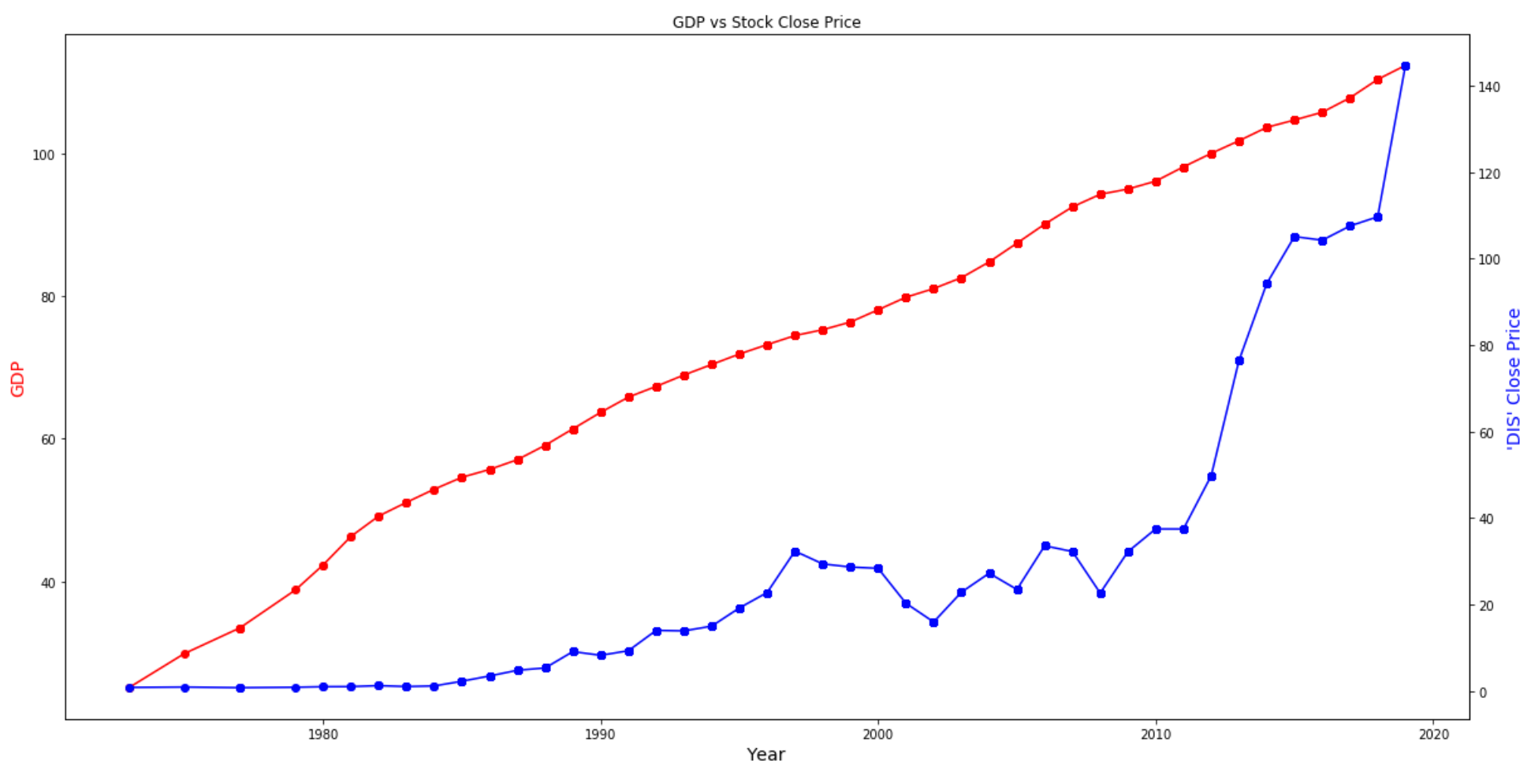
US GDP vs Stock Price
There not a strong correlation between the US GDP and the stock price. As seen in the graph, both the US GDP and the stock price have gone up from 1980s till present, however, the GDP goes up gradually every year, and the Disney stock price’s primary movement is gradually increasing throughout time, but there are a few years where we’ve seen a drop in price.

Slide 14

Analysis.
The S&P 500 Index

Slide 15
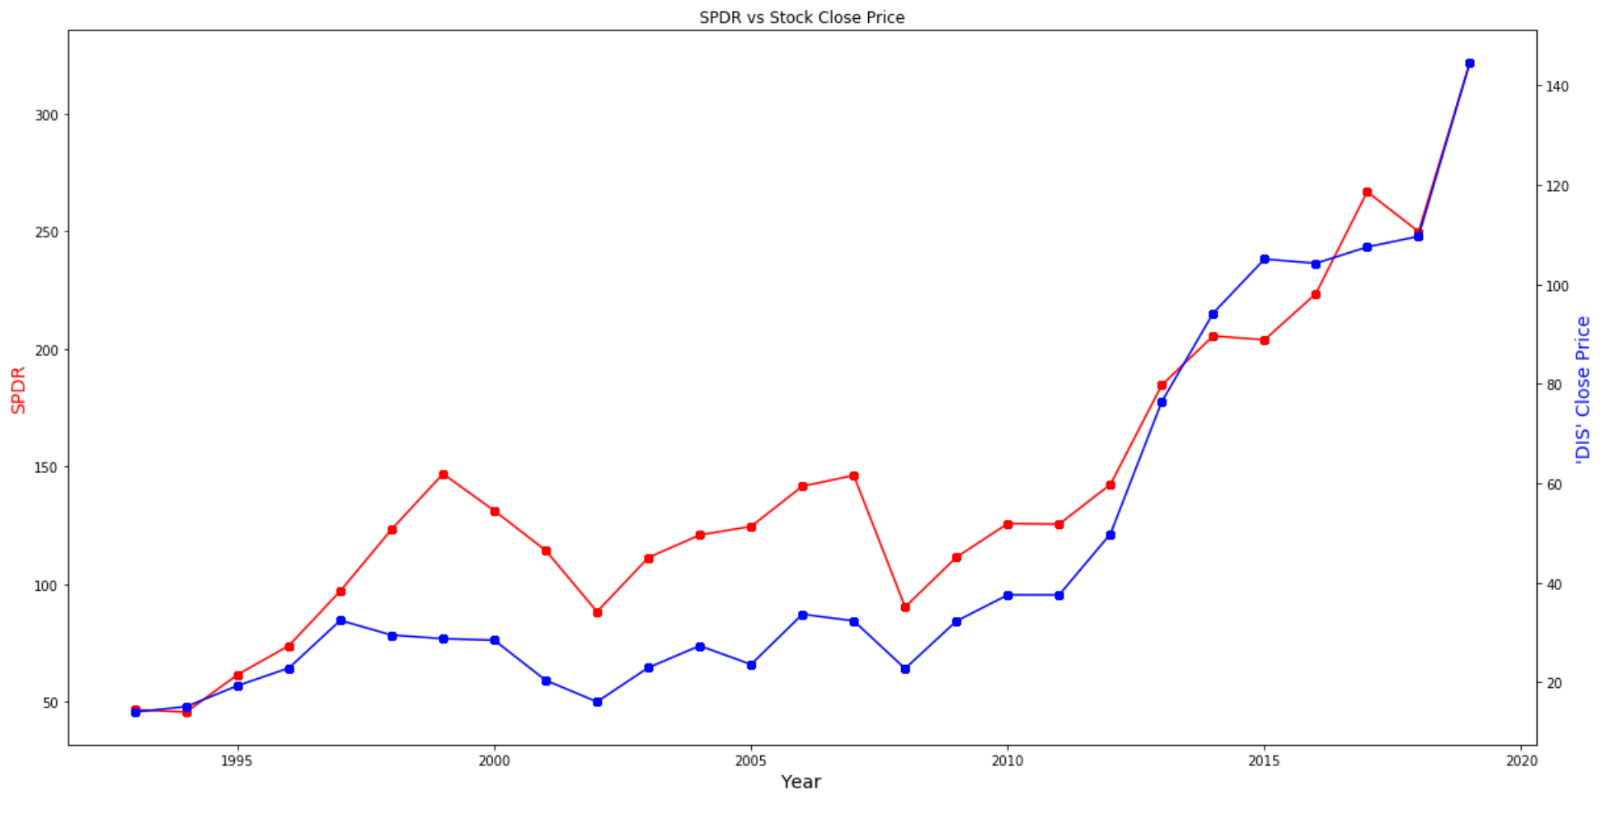
S&P 500 Index vs Stock Price
There is a direct correlation between S&P 500 Index and the stock price. As seen in the graph, the S&P 500 and stock price have seen a similar movement in price. When the S&P Index goes up, Disney stock price goes up; and when the S&P Index goes down, Disney stock price goes down

Slide 16
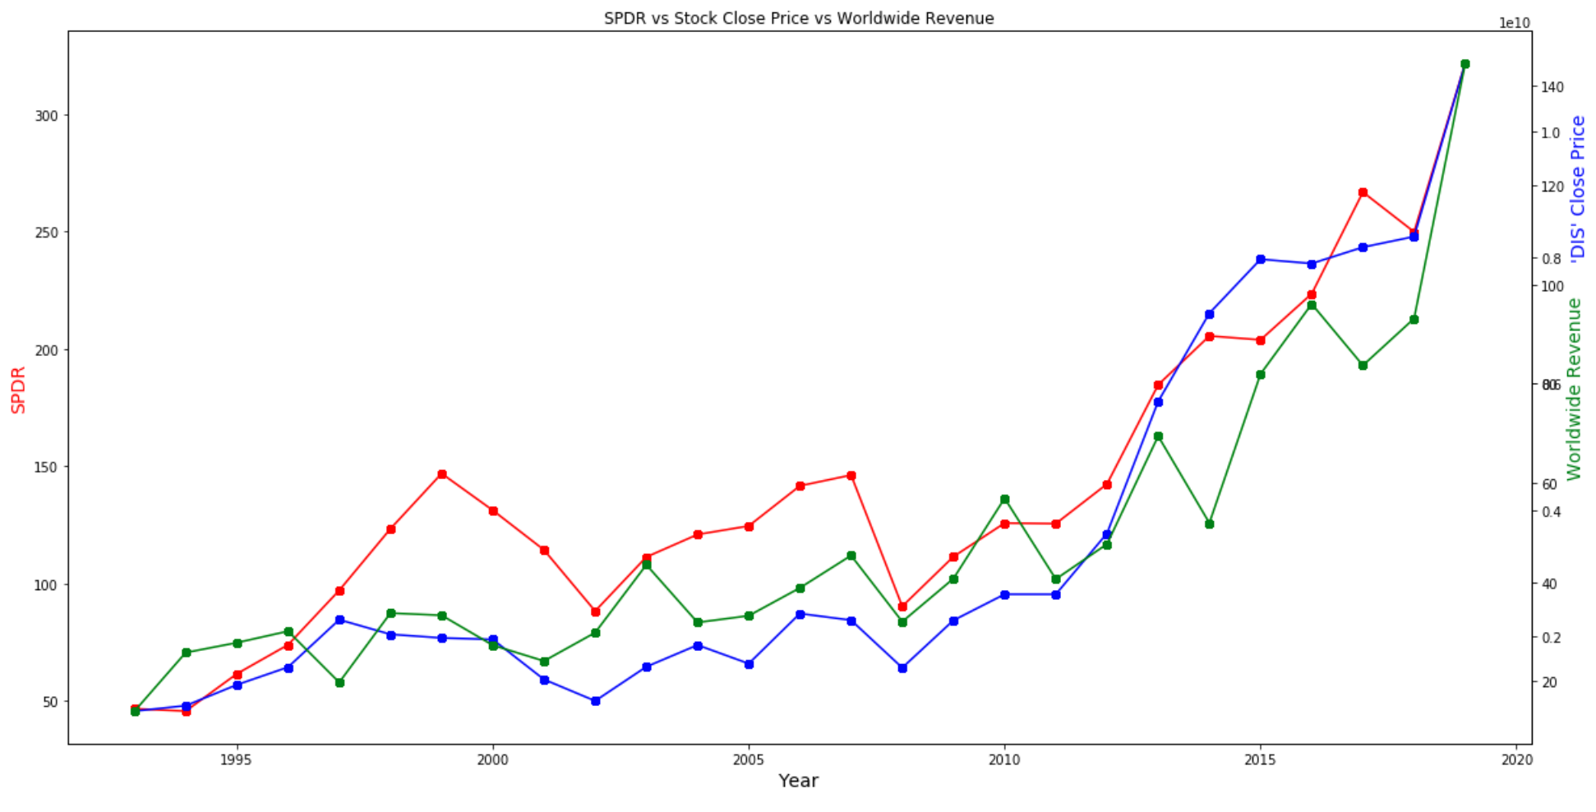
S&P Index vs Stock Price vs Box Office Revenue
There are direct correlations between S&P Index, Disney stock price and box office revenue as seen from the graph on the right. Their movements are in the same direction. When the S&P and stock price raise, the box revenue raise; when the S&P and stock price fall, the box revenue fall.

Slide 17

Analysis.
Unemployment rate and initial claims.
Does the unemployment rate and initial unemployment claims have a correlation with Disney stock price?

Slide 18
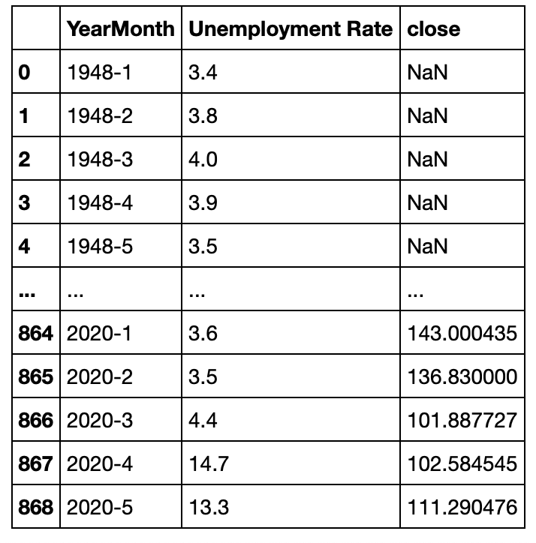
Data.
Data Cleaning
Data cleaning for all three datasets involved formatting and grouping by Year-Month and removing rows with any null values.

Slide 19
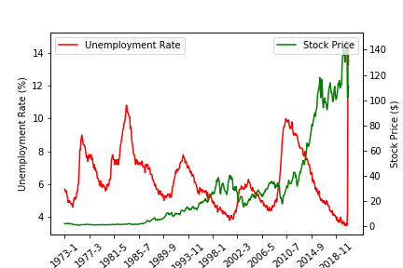
Data.
Unemployment Rate vs. Stock Price
It is evident that particularly after year 1989, unemployment rate and stock price are inversely correlated. The correlation coefficient is -0.36.

Slide 20
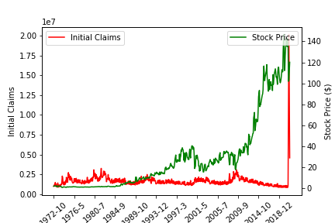
Data.
Initial Claims vs. Stock Price
There is not much correlation between initial unemployment claims and stock price. The correlation coefficient is -0.02. However, we do see an interesting spike in claims after March 2020.

Slide 21

Analysis.
Newsworthiness.
Based on New York Times articles, does the number of articles per week represent the magnitude of change in the stock price?

Slide 22
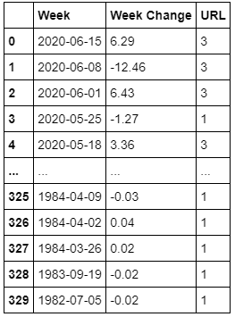
Data.
Combined data.
With historical stock price data, we were able to create a table that calculated the change in price during a specific week, along with the number of NYT articles based on publish date.

Slide 23
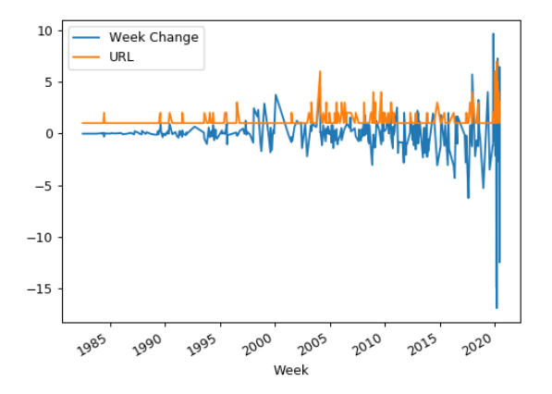
Data.
Count of Articles vs. Weekly Change in Stock Price
With a quick eye test, we see occurrences of the two lines spiking together. Since we are just looking for change (positive or negative), anytime the article count spikes, we should see fluctuation with the stock price.

Slide 24
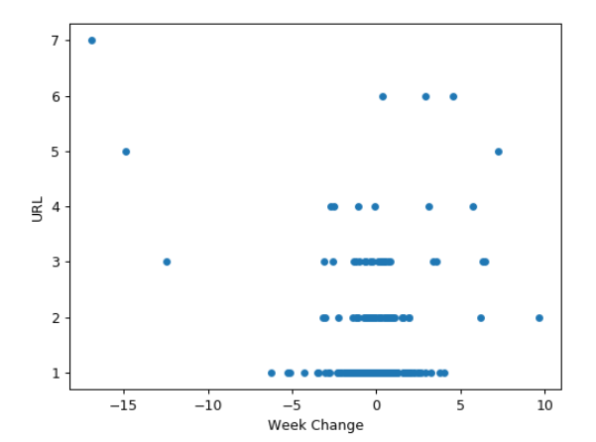
Data.
Count of Articles vs. Weekly Change in Stock Price
Using a scatter plot, we see that as we move higher up in article count, the more we see points move towards the sides, representing a large stock price change.

Slide 25

Analysis.
Retail Investors and
Disney

Slide 26
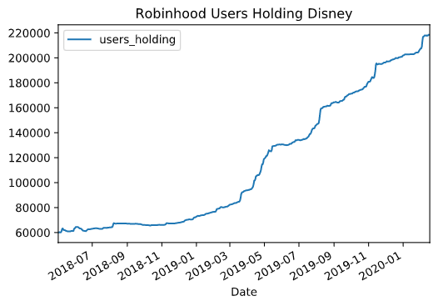
Robinhood Users vs. Disney
Robinhood users have been piling into Disney stock since the inception of the application, and now over 200,000 users hold the stock in their portfolios.

Slide 27
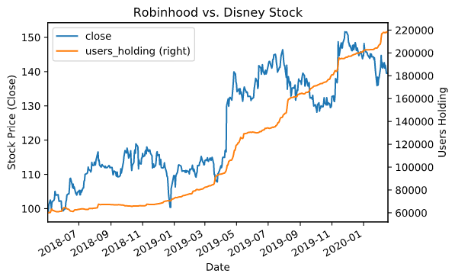
Robinhood Users vs. Disney
The added effect of retail investors on Robinhood buying into the stock has a positive effect on its price over time.

Slide 28

Summary.

Slide 29

What’s next?

Slide 30
What’s next?
Look into more factors that correlate with the stock price.
Find ways to collate the correlations and determine a profitable strategy for predicting Disney’s stock price.
Leverage the strategy for monetary gain.

